Slide 1
Reducing Redux Abstractions
Alexander Pittendrigh

Slide 2
Redux
Predictable state container for JavaScript applications
Works anywhere JavaScript runs
Primarily used on the web, when state management becomes a chore
react-redux (https://github.com/reduxjs/react-redux)
ngrx (https://github.com/ngrx/store)
vuex (https://github.com/vuejs/vuex)

Slide 3
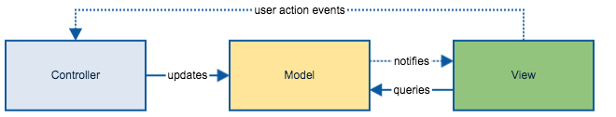
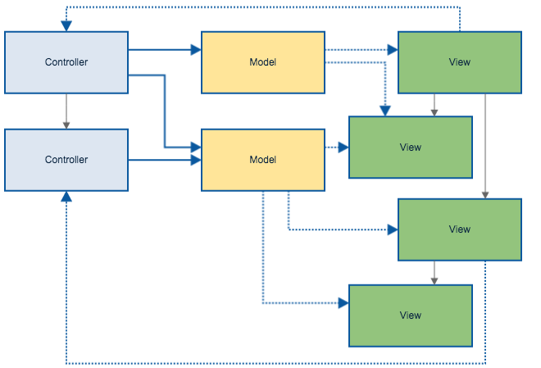
What’s wrong with traditional state management?
Everything changes everything

Slide 4


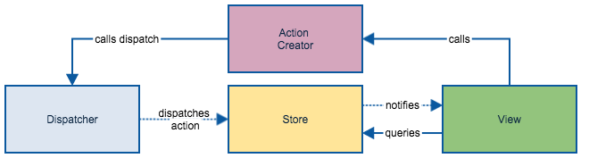
Flux Pattern

Slide 5

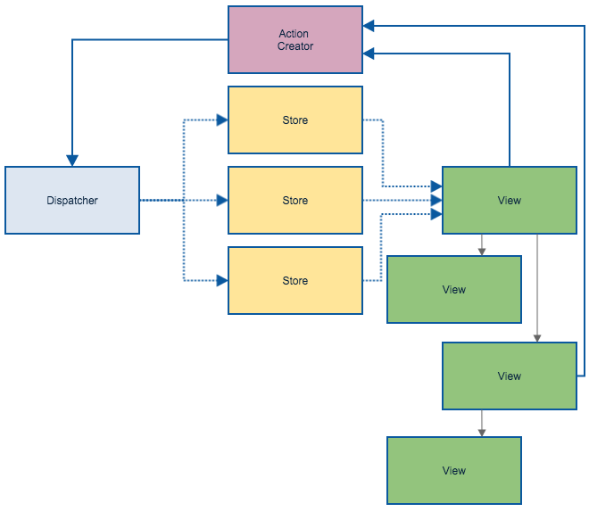

Slide 6
Why?
Unidirectional data flow
Every change of state has only one easily trace-able, corresponding action
Action handlers are synchronous
Inversion of control
Action handlers are pure
Action handlers are easy to test, because they’re pure

